Slide 1

HEART DISEASE EARLY RISK PREDICTION USING MULTI-DATASET ANALYSIS

Slide 2
PROBLEM STATEMENT
Heart disease is one of the major causes of death worldwide. It can develop due to multiple interacting risk factors such as high blood pressure, high cholesterol, diabetes, obesity, unhealthy lifestyle, and abnormal heart rate.
Early detection is difficult because symptoms may vary between individuals and some high-risk patients may show few or no noticeable symptoms.
Therefore, there is a need for an effective early heart disease risk prediction system that can analyze patient health factors and help identify individuals who may be at higher risk.

Slide 3
OBJECTIVES
To integrate data preprocessing, exploratory data analysis, and feature selection within a single analytical framework.
To incorporate SHAP and LIME techniques to provide clear and interpretable explanations of model predictions.
To implement realistic input validation to ensure only clinically plausible values are processed.
To develop an interactive Streamlit dashboard that unifies prediction, explanation, and visualization in one platform.
To compare multiple machine learning classifiers using standard performance metrics to identify the most suitable model.

Slide 4
LITERATURE SURVEY — PAPERS 1 TO 5
Research Paper | Publication | Key Contribution | Limitations
Feature-Limited Prediction on the UCI Heart Disease Dataset (2023) | Computers, Materials & Continua | Performs EDA on the UCI dataset, examines feature distributions and missing values, applies feature selection, and compares multiple ML models. | Limited to EDA and feature selection; does not incorporate explainability or a deployment interface.
An Active Learning Machine Technique Based Prediction of Cardiovascular Heart Disease from UCI-Repository Database (2023) | Scientific Reports | Performs preprocessing, EDA, and visualization to examine attribute relationships before applying multiple ML classifiers. | Focuses on classification performance only; lacks explainability (SHAP/LIME) and input validation.
Mixed Machine Learning Approach for Efficient Prediction of Human Heart Disease by Identifying Numerical and Categorical Features (2022) | Applied Sciences – MDPI | Uses combined UCI data (Cleveland, Hungary, Switzerland, VA Long Beach); analyzes numerical/categorical features and compares ML approaches. | Does not include model interpretability or an interactive deployment component for practical use.
Finding the Influential Clinical Traits that Impact on the Diagnosis of Heart Disease Using Statistical and Machine-Learning Techniques (2022) | Scientific Reports | Investigates feature importance using statistical and ML techniques before applying tree-based classifiers on the combined UCI dataset. | Limited to feature-importance analysis; lacks broader model comparison and explainability integration.
The Efficacy of Machine-Learning-Supported Smart System for Heart Disease Prediction (2022) | Healthcare – MDPI | Evaluates Random Forest, Decision Tree, AdaBoost and KNN; compares performance on combined vs. Cleveland-only datasets. | Provides no model explainability or interactive interface for end users.

Slide 5
LITERATURE SURVEY — PAPERS 6 TO 10
Research Paper | Publication | Key Contribution | Limitations
Predict2Protect: Machine Learning Web Application in Early Detection of Heart Disease (2023) | Peer-reviewed biomedical publication | Develops a machine-learning-based web application for early heart disease detection using the combined dataset. | Lacks explainability techniques (SHAP/LIME) and does not implement input validation for unrealistic clinical values.
Comprehensive Evaluation and Performance Analysis of Machine Learning in Heart Disease Prediction (2024) | Scientific Reports | Provides comparative evaluation of ML approaches and emphasizes assessment using multiple performance measures. | Primarily evaluative in nature; does not incorporate deeper feature selection, explainability or deployment.
XAI–reduct: Accuracy Preservation Despite Dimensionality Reduction for Heart Disease Classification Using Explainable AI (2023) | Biomedical research publication | Applies dimensionality reduction and Explainable AI to improve transparency of heart disease classification. | Focuses on dimensionality reduction and explainability alone; no interactive deployment or input validation.
Explainable Soft-Voting Classifier for Heart Disease Prediction Using SHAP and LIME (2026) | Discover Computing – Springer Nature | Combines ML models with SHAP and LIME to provide global and local explanations for heart disease predictions. | Does not extend to interactive deployment or real-time input validation for clinical use.
A Hybrid Framework for Heart Disease Prediction Using Classical and Quantum-Inspired Machine Learning Techniques (2025) | Scientific Reports | Uses combined datasets (Cleveland, Hungary, Switzerland, Long Beach, Statlog) with extensive EDA and visualization before ML modelling. | Requires specialized quantum-inspired computation; lacks explainability and an interactive user interface.

Slide 6
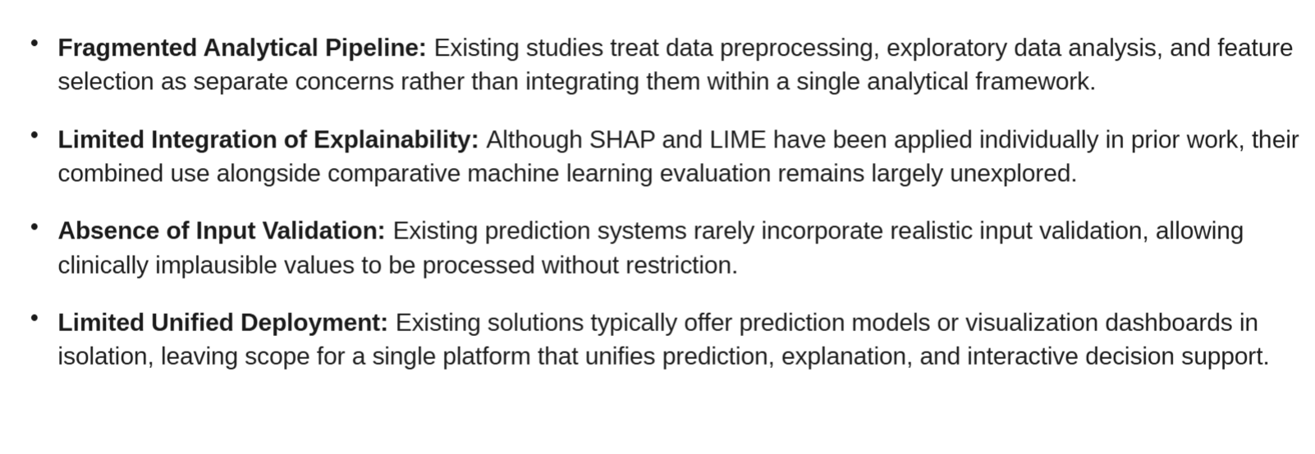
RESEARCH GAP
Existing research has extensively used the UCI Heart Disease dataset for machine learning prediction and exploratory data analysis.
Several studies have performed data visualization to identify feature distributions, correlations, and clinical patterns.
Existing studies have compared multiple machine learning models, including Random Forest, Decision Tree, KNN, Logistic Regression, and SVM/SVC.
Recent research has also introduced SHAP and LIME-based explainability for heart disease prediction.
Therefore, the novelty of the proposed work is not the use of the UCI dataset or machine learning alone.
The research opportunity lies in integrating data preprocessing, EDA, feature selection, comparative ML evaluation, SHAP and LIME explainability, realistic input validation, and interactive Streamlit deployment into one unified framework.
The proposed system focuses on connecting predictive performance with interpretable explanations and practical usability.

Slide 7
DATASET
UCI Heart Disease Dataset Overview
Source & Records
920 patient records total
Four geographic source locations:
Cleveland, USA
Hungary
Switzerland
Long Beach, USA
Dataset diversity reflects varied clinical and demographic populations
Publicly available via UCI Machine Learning Repository
Clinical Features
Age and sex
Chest pain type (4 categories)
Resting blood pressure
Serum cholesterol
Maximum heart rate achieved
Exercise-induced angina
ST depression (oldpeak)
ST slope
Additional clinical attributes
Target: Presence or absence of heart disease

Slide 8
PROPOSED METHODOLOGY
ML Pipeline:
Dataset → Preprocessing → Exploratory Data Analysis → Feature Selection → Machine Learning Models → Model Evaluation → Location-wise Analysis → Interactive Dashboard
Evaluation Metrics:
Accuracy, Precision, Recall, F1-Score, ROC-AUC, Confusion Matrix — ensuring robust prediction and insightful analytics through systematic ML and interactive visualization

Slide 9
DEVELOPED DASHBOARD
Patient-level heart disease risk prediction
Risk output with interpretability and explanation
Interactive visualizations of data and features
Location-wise dataset analysis and filters
Model performance and feature importance insights

Slide 10
KEY INNOVATIONS
Interactive Dashboard
User-driven heart disease risk prediction and exploration
Patient-level prediction with interpretability and risk output
Location-Wise Geographic Analysis
Analysis across four UCI dataset source locations: Cleveland, Hungary, Switzerland, Long Beach
Uncovers geographic variations in heart disease patterns
Unified ML + Visual Analytics Platform
Integration of machine learning prediction with interactive visualizations in one platform
Feature-based interpretation to explain model outputs and increase transparency
Transforms original research methodology into an interactive research prototype for academic and decision-support use

Slide 11
RESEARCH CONTRIBUTION & FEASIBILITY
Contributions
Extension of published heart disease prediction study with location-wise analysis across four UCI dataset sources
Integration of prediction and visualization into a unified interactive environment
Foundation for future explainable AI and cross-dataset research
Technical Feasibility
Built with Python and open-source ML and data visualization libraries (Scikit-learn, Plotly, Dash)
Uses the publicly available UCI Heart Disease Dataset
No specialized hardware required
Browser-based dashboard prototype accessible for research use

Slide 12
CONCLUSION & FUTURE SCOPE
Conclusion:
Successfully extended the feature-limited heart disease prediction framework by combining machine learning, location-wise analysis, and an interactive dashboard for risk analytics.
Future Scope:
Validation on additional heart disease datasets
Cross-dataset and generalization studies
Incorporation of advanced explainable AI methods
Use of larger, more diverse clinical datasets
Exploration of further relevant clinical and demographic features
Note: This system is a research and decision-support prototype — not a substitute for professional medical diagnosis.

Slide 13
THANK YOU

